Slide 1


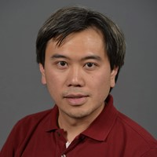


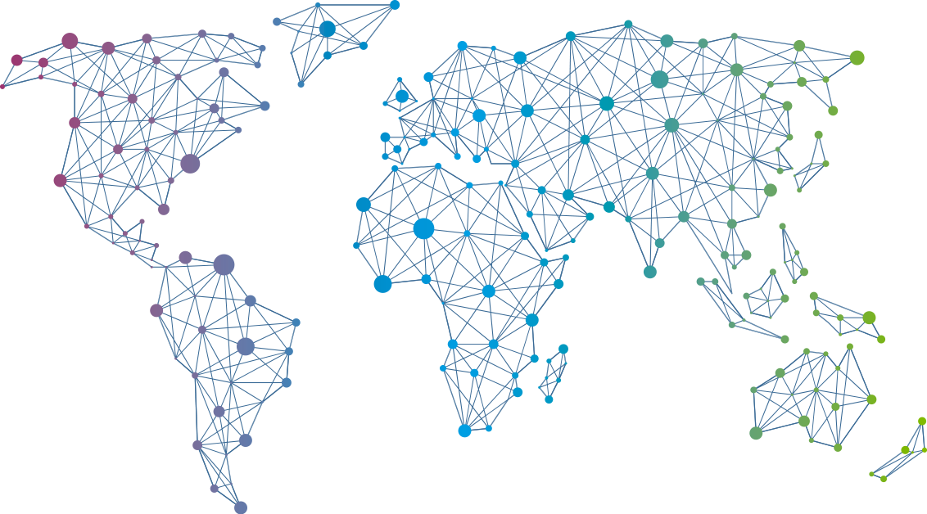

Speaker
Ron Dagdag
Serverless at the edge in Azure Percept
Ron Dagdag
RonDagdag
September 16th & 17th
^{Online Event}
Powered By
International Conference

